Slide 1


Neural Network Essentials
Biological inspiration · Artificial neurons · Activations · Layers · MLP · Backpropagation · Optimization

Slide 2
What's for today
• What a neural network actually receives as input and produces as output.
• Difference between biological and artificial NN.
• How a perceptron becomes a neuron, a layer, and finally a multilayer perceptron.
• Why activation functions are necessary for nonlinear learning.
• How loss, backpropagation and gradient-based optimization train a network.
• How scaling, initialization, regularization and validation affect generalization.
• Neural Networks are Decision Trees.

Slide 3

1. Biological neurons and artificial neurons
Neuron really is a mathematical abstraction.

Slide 4
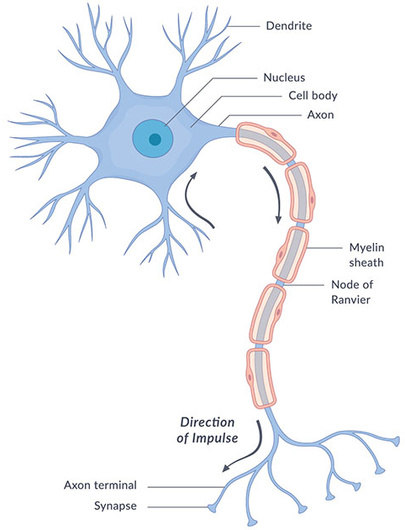
The biological neuron
• Dendrites receive signals from many other cells.
• Synapses modulate the strength and sign of those inputs.
• Membrane voltage integrates signals over space and time.
• If biophysical conditions are met, an action potential can be generated and propagated along the axon.
• Real neurons also exhibit dendritic computation, adaptation, neuromodulation and many cell-type-specific dynamics.

Slide 5
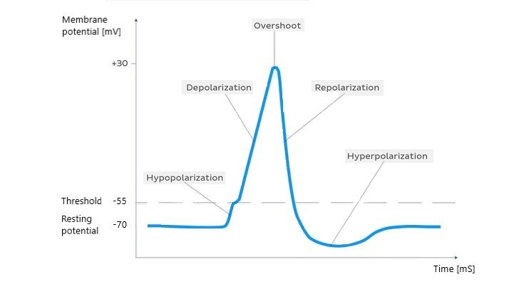
The biological neuron
• Dendrites receive signals from many other cells.
• Synapses modulate the strength and sign of those inputs.
• Membrane voltage integrates signals over space and time.
• If biophysical conditions are met, an action potential can be generated and propagated along the axon.
• Real neurons also exhibit dendritic computation, adaptation, neuromodulation and many cell-type-specific dynamics.

Slide 6
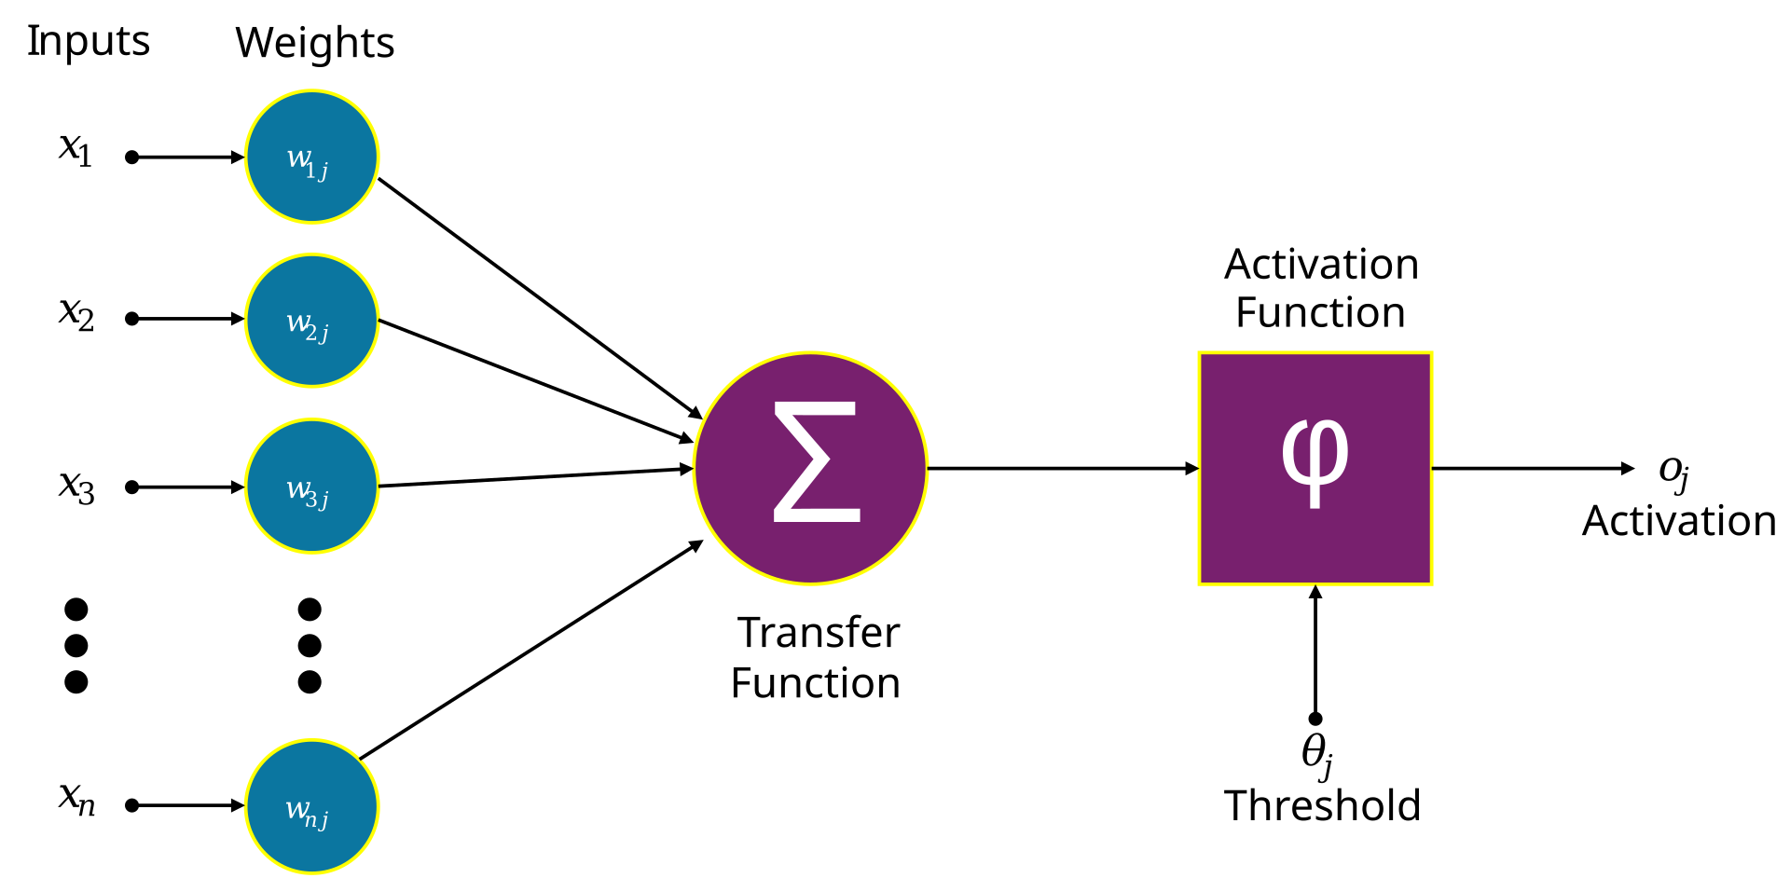
Biological neuron vs artificial neuron

Slide 7

2. From a linear model to a neuron
A neuron is almost a regression equation with a nonlinear step added.

Slide 8
An artificial neuron step by step
x₁
x₂
weighted sum
z = Σ wᵢxᵢ + b
activation
a = f(z)
output
a
x₃
…
Bias b
Bias shifts the activation threshold independently of the input values.
Without b, the decision boundary is forced through the origin.
xₚ

Slide 9
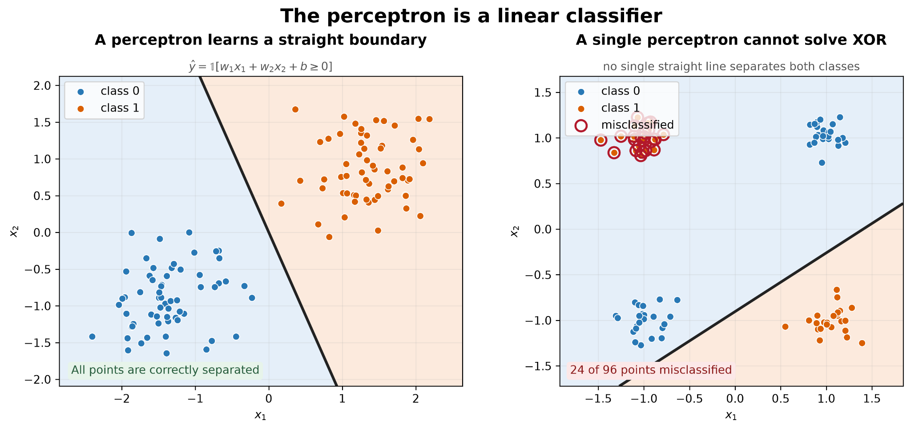
The perceptron: a hard threshold
• The classical perceptron computes z = wᵀx + b.
• A step function then returns one of two states depending on whether z crosses a threshold.
• This creates a learned linear decision boundary.
• Modern networks usually replace the hard step with differentiable or piecewise-differentiable activations.

Slide 10
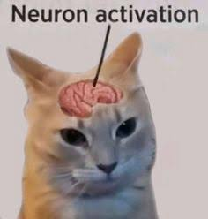
3. Activation functions
How we can transform weighting into non-linear function.

Slide 11
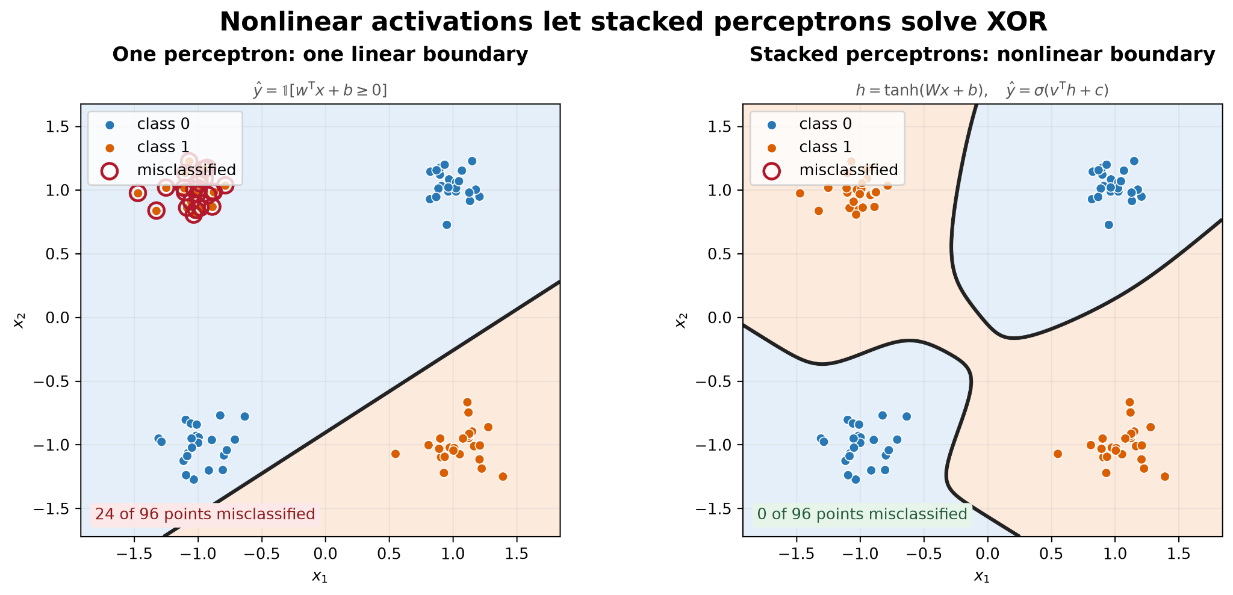
Why activation functions are necessary
• Suppose h₁ = W₁x + b₁ and h₂ = W₂h₁ + b₂.
• Then h₂ = W₂W₁x + W₂b₁ + b₂ — still just a linear/affine transformation.
• Therefore stacking linear layers without nonlinear activations does not create a nonlinear model.
• Activations let networks build nonlinear decision surfaces and intermediate representations.

Slide 12
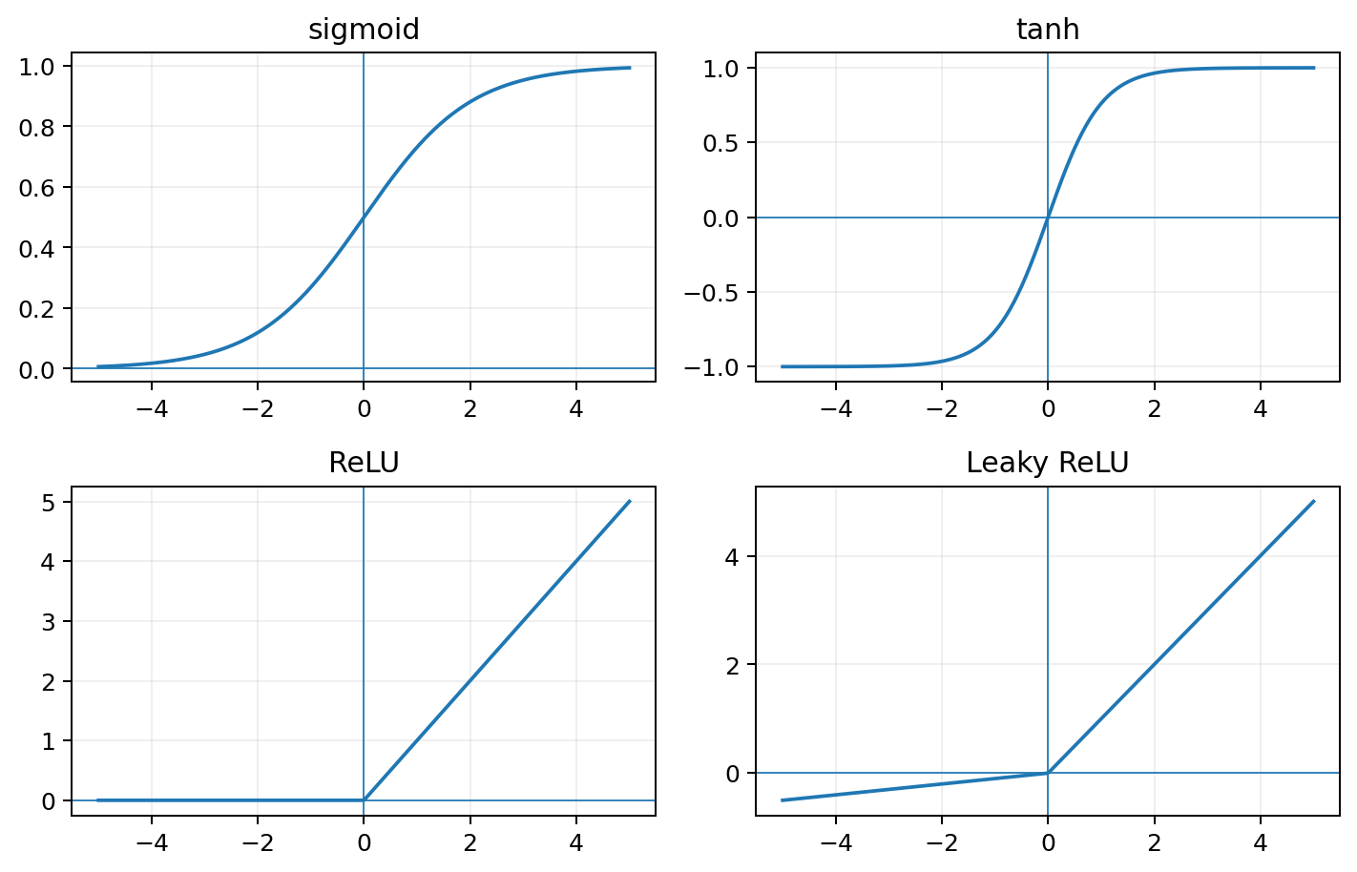
Common activation functions
• Sigmoid: bounded 0–1; useful for binary probability output, but saturates in hidden layers.
• tanh: bounded −1 to 1 and zero-centered, but also saturates.
• ReLU: simple and widely used in hidden layers.
• Leaky ReLU: keeps a small slope for negative inputs to reduce “dead” units.

Slide 13
Activation function choice should be aligned with your task
Hidden layers
Output layer
Why?
ReLU / Leaky ReLU
Regression
Usually linear output
Predict unrestricted real values
ReLU / Leaky ReLU
Binary classification
1 sigmoid output
Probability in [0,1]
ReLU / Leaky ReLU
Multiclass
K logits / softmax
One probability distribution
ReLU / Leaky ReLU
Multilabel
K sigmoids
Independent probabilities

Slide 14
You can create your own function
1. It should solve a real modelling problem
2. Gradient-based training needs a usable derivative
3. Numerical stability matters
Examples of why new activations appeared:
• Leaky ReLU → avoid permanently inactive negative units
• GELU / SiLU → smoother gating used in many modern architectures
• Task-specific monotonic or bounded functions → encode domain constraints
But changing f(z) changes optimization too.
Ask:
• Does it saturate?
• Are gradients stable?
• Is the output range appropriate?
• Does it improve validation performance?

Slide 15
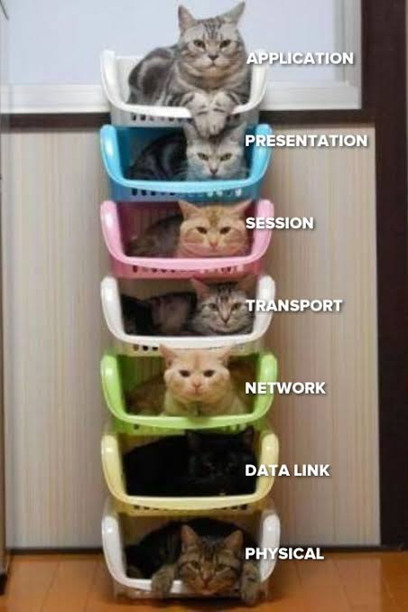
4. Inputs, layers and representations
A network is a sequence of tensor transformations.

Slide 16
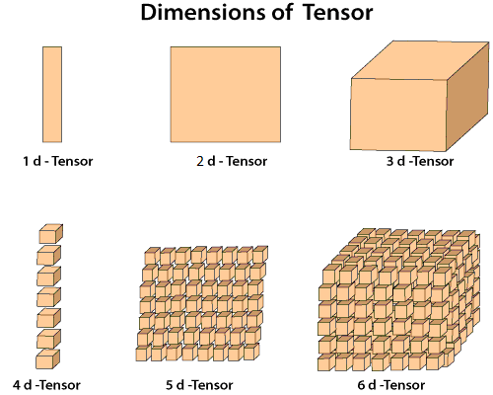
What does the network actually see?
• A network receives numbers arranged in tensors
• Tabular input: where rows are samples and columns are features.
• Transcriptomics example: one sample → vector of gene-expression values.
• QSAR example: one compound → vector of molecular descriptors.
• Microscopy-feature example: one cell → vector of morphology and texture measurements/multidemensional matrix.

Slide 17
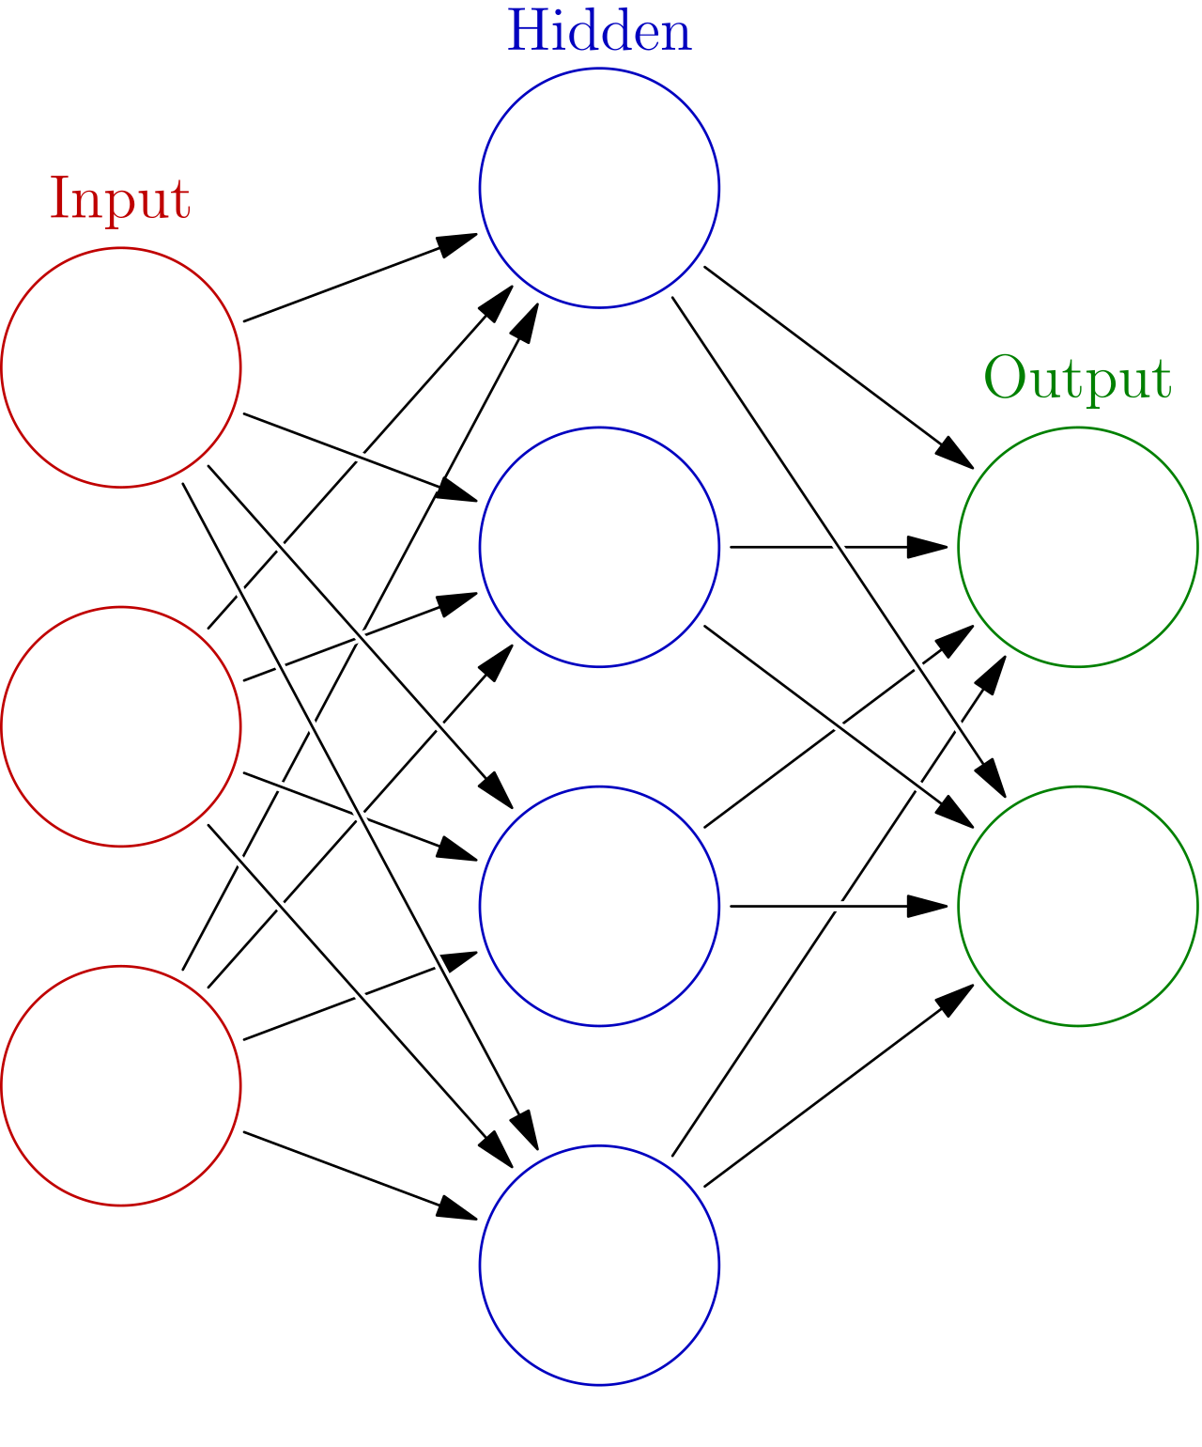
A layer is many neurons in parallel
• A dense layer computes z = Wx + b.
• If input dimension = p and layer width = h, then W has shape h × p.
• The activation is applied element-wise: h = f(z).
• The layer therefore maps one representation into another.

Slide 18
Dense layer
128 neurons
1000 input features
128 outputs
weights: 1000 × 128 = 128,000
biases: 128

Slide 19
Input, hidden and output layers
• Input layer: the representation supplied by the dataset.
• Hidden layers: learned intermediate representations.
• Output layer: dimensionality and activation chosen for the prediction task.
• Width = number of units in a layer; depth = number of successive learned layers.

Slide 20

5. Multilayer perceptron
Dense layers + nonlinear activations + task-specific output.

Slide 21
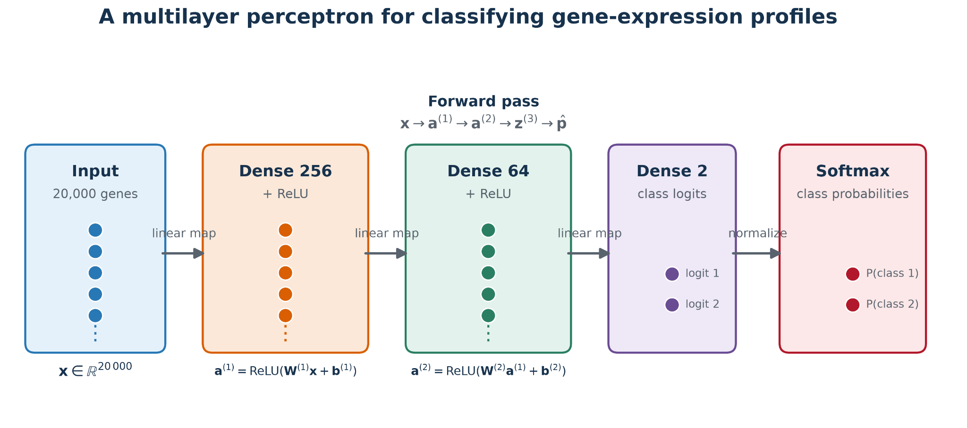

Slide 22
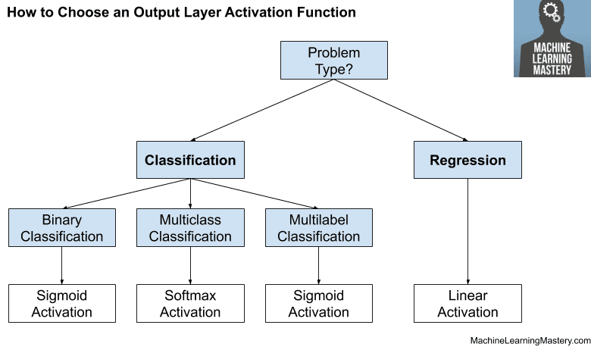
Output layer depends on the task

Slide 23
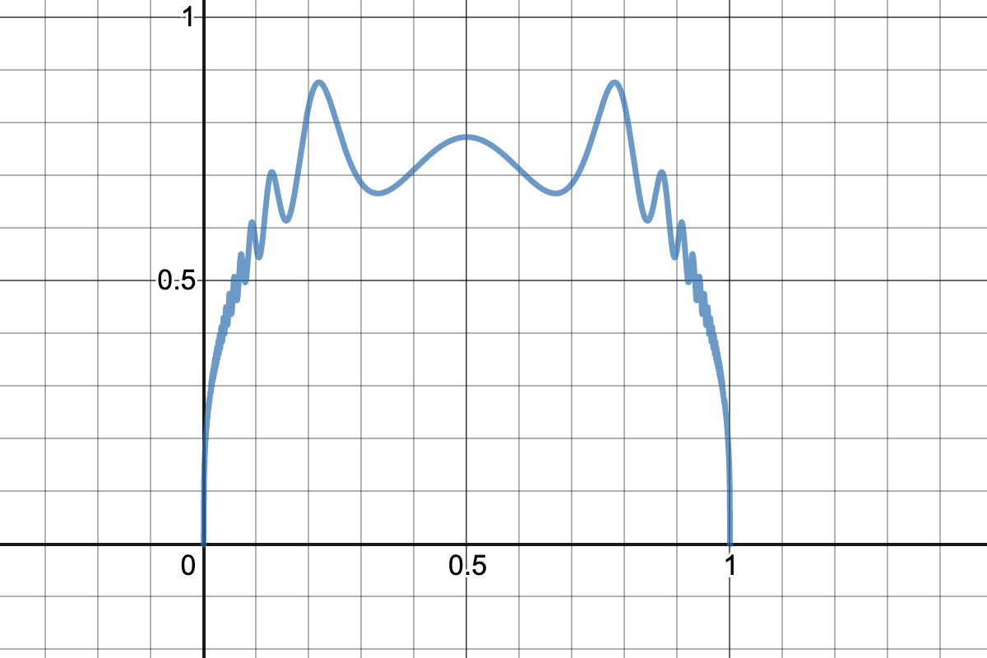
6. Loss functions
The loss defines how we measure efficacy.

Slide 24
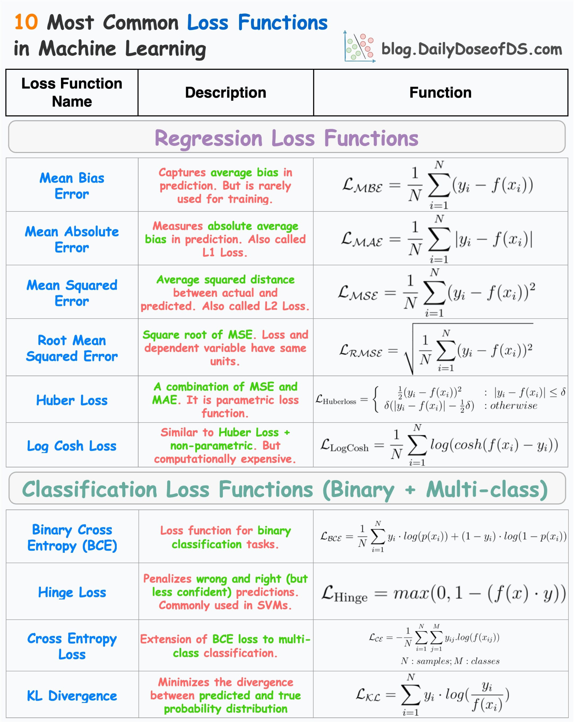

Slide 25
You can build your own(task specific) loss
You can build your own(task specific) loss
Standard loss
MSE / BCE / CE
Domain penalty
λ · R(ŷ, x)
Task-specific objective
+
=
Biology-specific examples:
• penalize biologically impossible negative concentrations;
• weight rare disease classes more strongly;
• combine prediction error with pathway/structure constraints;
• penalize violations of monotonic dose–response behavior.
Requirements:
• differentiable or sub-differentiable;
• numerically stable;
• correctly scaled relative to the main objective;
• validated against the scientific goal, not only training loss.

Slide 26

7. How a neural network learns
Forward pass → loss → gradients → parameter update.

Slide 27
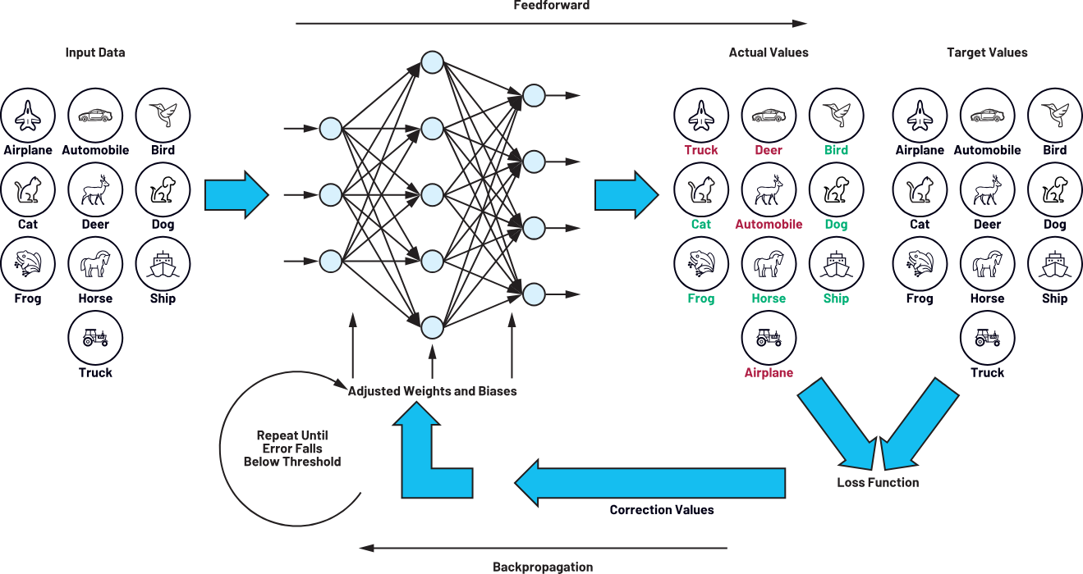
The training loop
repeat for many mini-batches and epochs

Slide 28
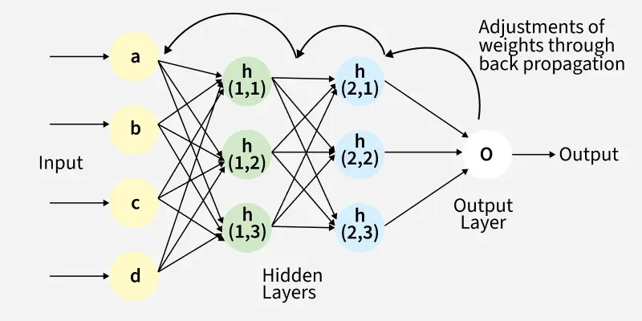
Backpropagation
• For a computation x → z → a → L, each operation contributes a local derivative.
• The gradient of the loss with respect to a parameter is obtained by chaining derivatives backward.
• Automatic differentiation frameworks compute these gradients for large computational graphs.

Slide 29
9. Optimization
Gradients tell us a direction; the optimizer decides how to move.

Slide 30
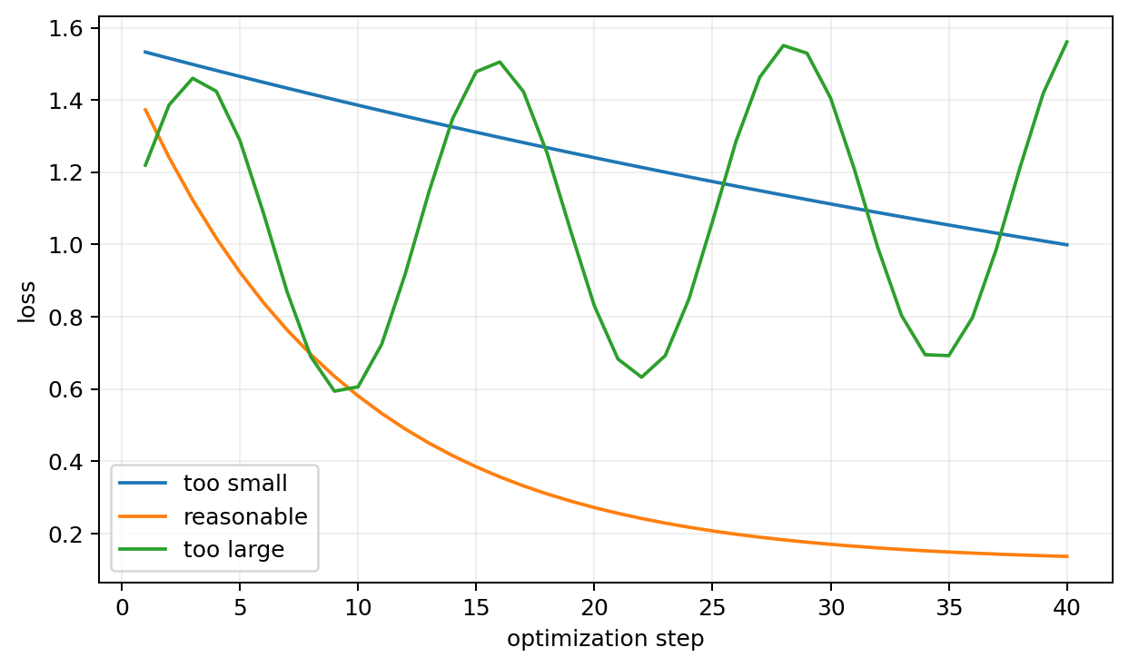
Learning rate changes training behavior
• Very small learning rate: stable but inefficient.
• Reasonable learning rate: rapid loss reduction.
• Too large: unstable updates and possible divergence.
• Learning-rate schedules can reduce η during training.

Slide 31
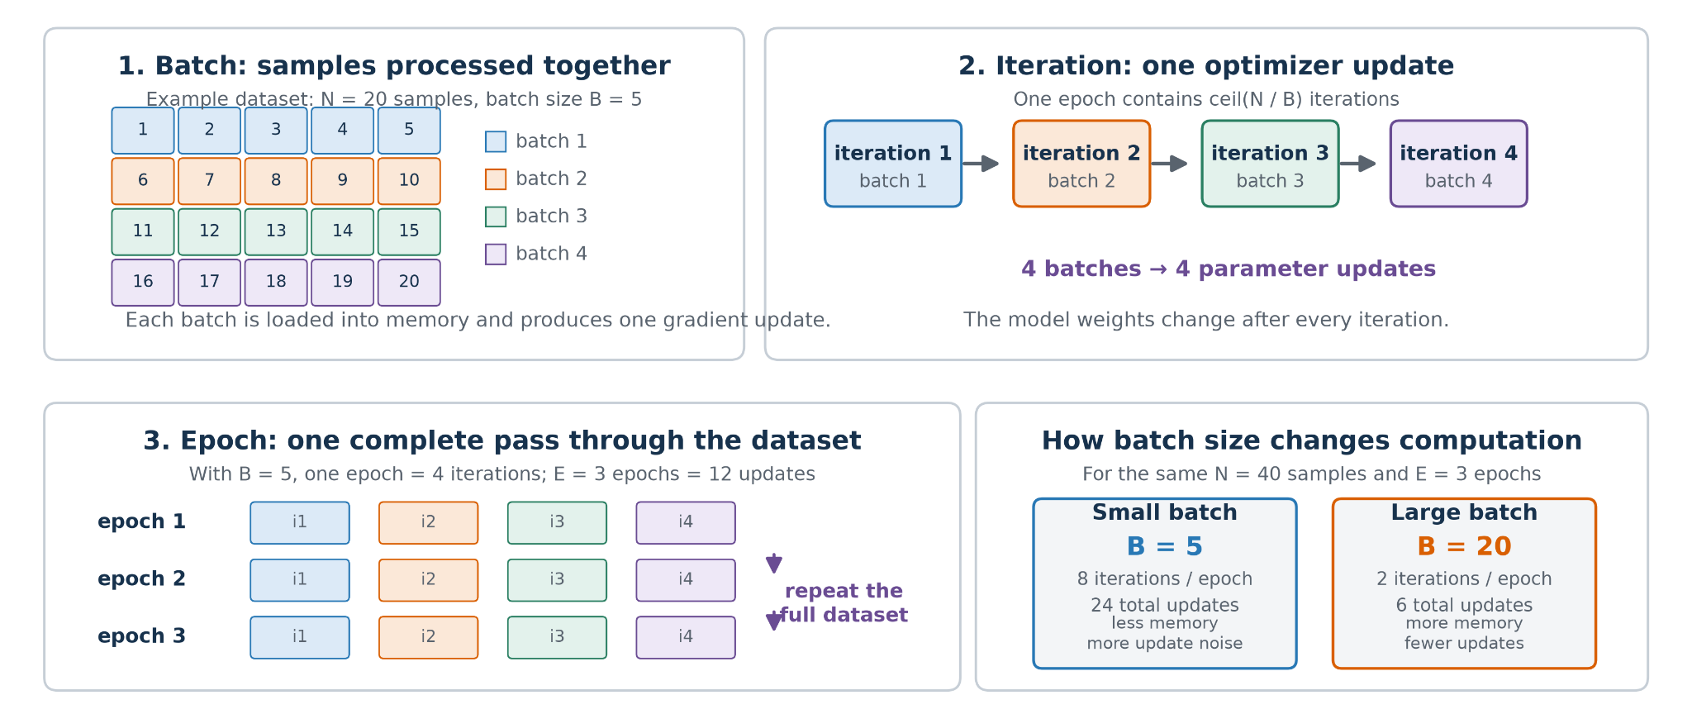
Batch, iteration and epoch
• Batch: subset of samples used for one gradient update.
• Iteration / optimization step: one forward + backward + update cycle.
• Epoch: one complete pass through the training dataset.
• Example: 1000 samples with batch_size=100 → about 10 optimization steps per epoch.

Slide 32
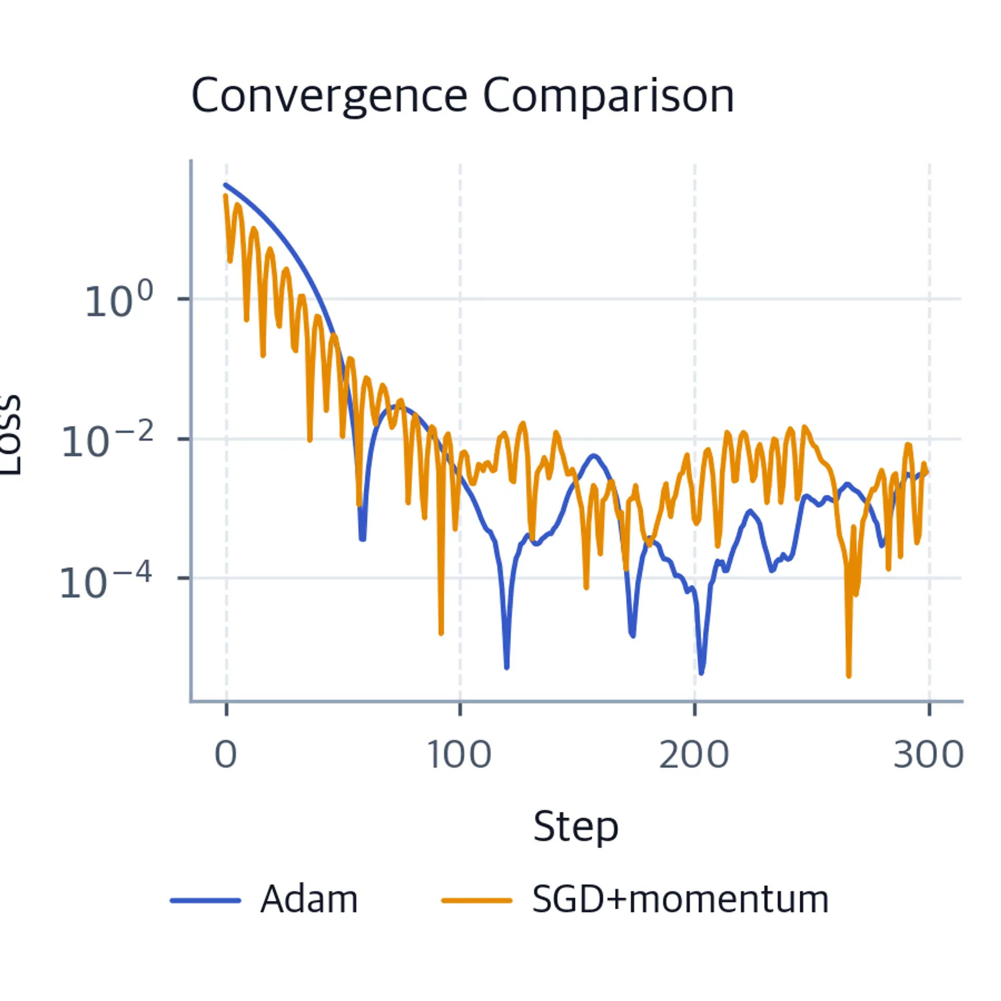
SGD, momentum and Adam
• SGD uses the current mini-batch gradient directly.
• Momentum accumulates direction across steps and can accelerate movement through shallow valleys.
• Adam keeps adaptive running estimates of gradient moments and is a common practical default.

Slide 33
10. Generalization and regularization
Training loss is not the goal — performance on unseen data is.

Slide 34
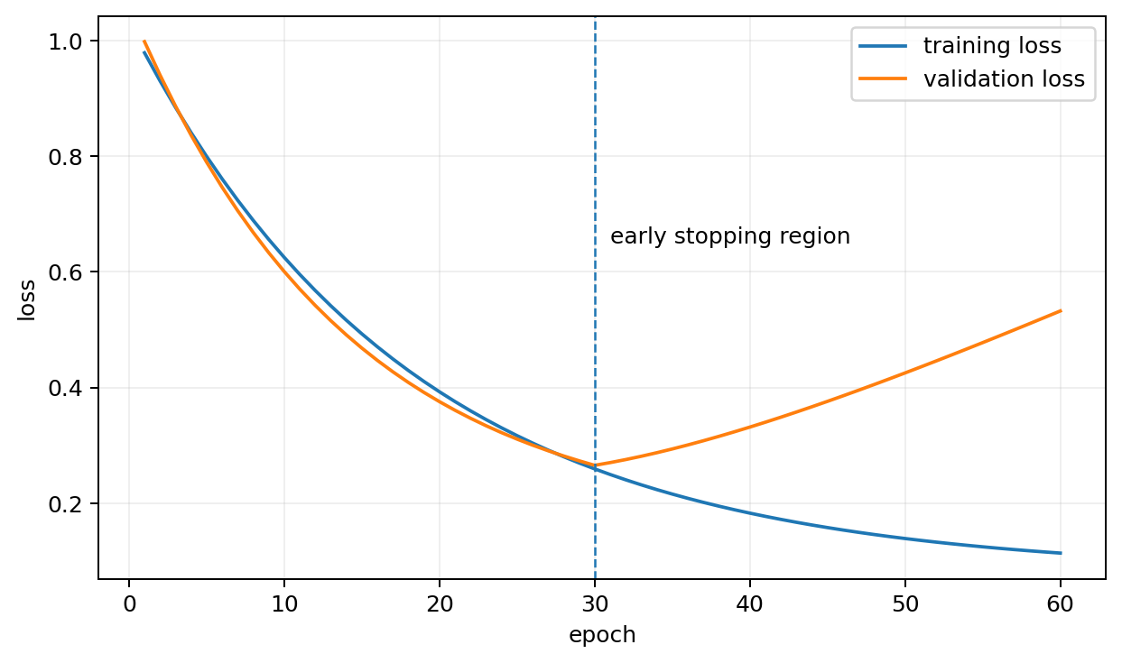
Neural networks can overfit
• Training loss can continue to improve while validation performance deteriorates.
• Small biological datasets are especially vulnerable.
• Always monitor validation metrics, not only training loss.
• Early stopping can preserve the model from the best validation epoch.

Slide 35
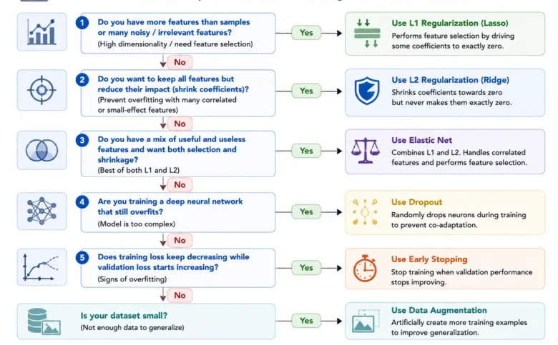
Regularization strategies
• Weight decay / L2 discourages excessively large weights.
• Dropout randomly removes a fraction of activations during training.
• Early stopping limits training once validation performance stops improving.
• Reducing model width/depth is also a form of capacity control.
• The best regularization strength depends on data size and noise.

Slide 36

3. Are neural networks decision trees?
Wait, are they?

Slide 37
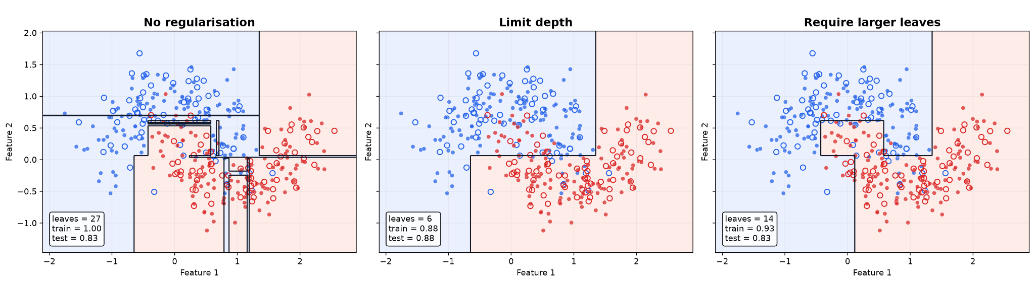
Week 5 recap: trees partition feature space
• A tree routes a sample through explicit conditional rules.
• Each split creates a boundary and divides the feature space into regions.
• Only one root-to-leaf path is followed for a given sample.
• Deep trees therefore implement piecewise predictions over many regions.

Slide 38
Aytekin (2022): “Neural Networks are Decision Trees”
• The paper proves that a neural network can be represented by an equivalent decision tree not merely approximated by one.
• The claim is stated for arbitrary activation functions and covers fully connected and convolutional networks.
• The construction can also accommodate architectures with skip connections and normalization layers.
• The point is representational equivalence: the tree can reproduce the network output exactly.

Slide 39
Tree logic vs neural-network logic
Decision tree
Neural network
Rule
xⱼ < t
Rule
wᵀx + b
Routing
hard / one path
Routing
many units active
Boundary
often axis-aligned
Boundary
oblique / composed
Representation
explicit hierarchy
Representation
distributed

Slide 40

11. Putting the MLP together
From tensor input to prediction and training loop.

Slide 41
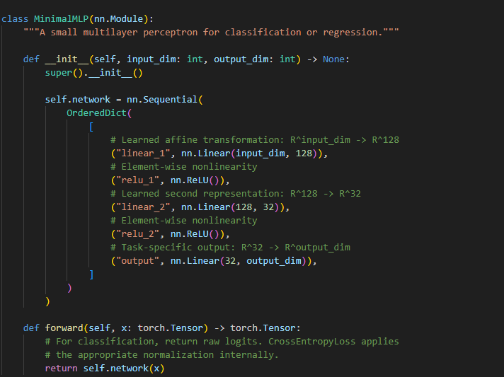
A minimal MLP in PyTorch
• Linear(input_dim, 128) → learned affine transformation.
• ReLU() → nonlinearity.
• Linear(128, 32) → second learned representation.
• ReLU() → nonlinearity.
• Linear(32, output_dim) → task-specific logits or prediction.

Slide 42
A good baseline MLP workflow
• Split data correctly before any learned preprocessing.
• Normalize/standardize the input representation.
• Start with a small MLP rather than a very deep network.
• Monitor train and validation curves.
• Tune learning rate, width/depth, weight decay and possibly dropout.
• Evaluate once on the untouched test set.

Slide 43
Practical 6
• Manually compute one neuron and one small dense layer with NumPy.
• Plot activation functions and observe their effect on outputs/gradients.
• Build a small MLP for a biological tabular dataset in PyTorch.
• Write the training loop explicitly: zero_grad → forward → loss → backward → step.
• Compare learning rates and hidden-layer widths.
• Plot train/validation loss and add early stopping / weight decay.

